Slide 1
Weekly Project Review
AI Product Development

Slide 2
Project Overview
CareerSetu: connecting the alumni’s of our very own NSU and plan for scaling in the future.
Members: Jihanur Rahman Ratul, Tahsin Ahmed Sufol
Sprint – 1
Goal: to conduct research and surveys of 20th and 21st convocation graduates of our NSU and their informations like ID and email and collecting the data of companies from the internet.
Phase: Initial.

Slide 3
Sprint Goal
In our first sprint the goal is to conduct surveys among our peers who graduated and was part of the 20th or the 21st convocation and collecting their information and the information of well known companies of Bangladesh and curating those data into csv format.

Slide 4
Weekly Progress
Our week 1 tasks are communicated through slack and their progress are tracked through notion the screenshots are added in the communication and notion slide.

Slide 5
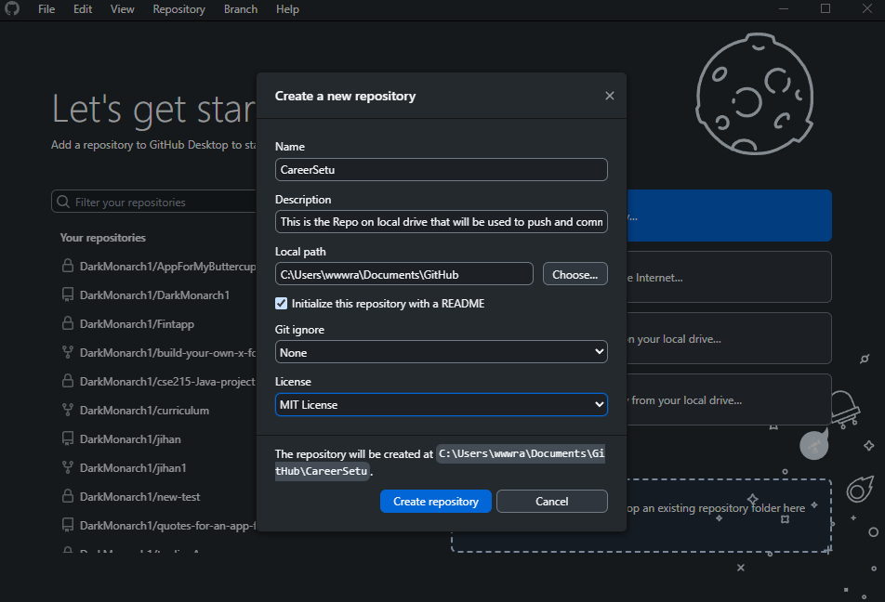
Code Contribution
GitHub commits, PRs, reviews
In initial phase all of our teammates created a repository on their local drive. Here is a screenshot of the repo on the local drive of one of our teammates:

Slide 6
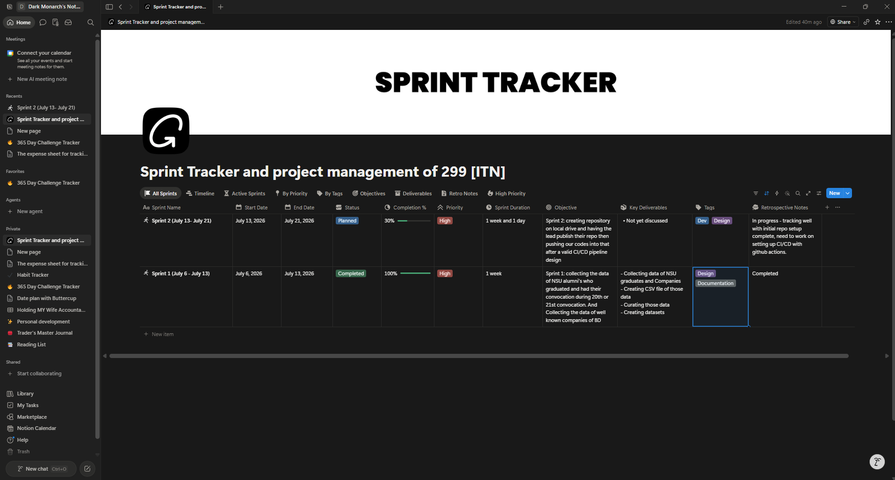
Notion Usage
The screenshot of our notion template and sprint tracking:
The link to view the project management tracker: https://app.notion.com/p/Sprint-Tracker-and-project-management-of-299-ITN-8dd69b84acd982fdac5601ddbb11a8d4?source=copy_link

Slide 7
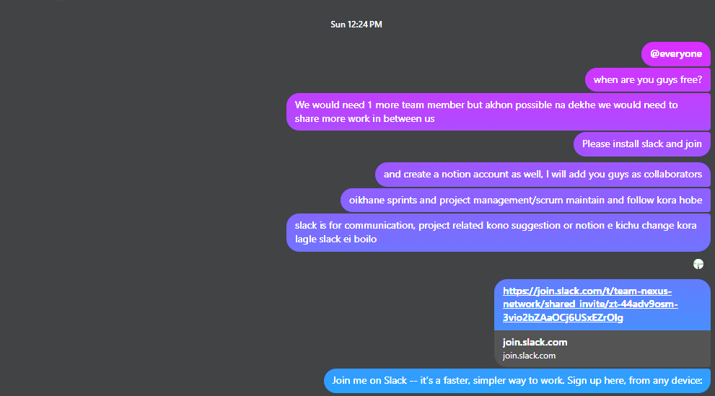
Communication Review
Slack screenshots and metrics:
The initial communication before slack:

Slide 8
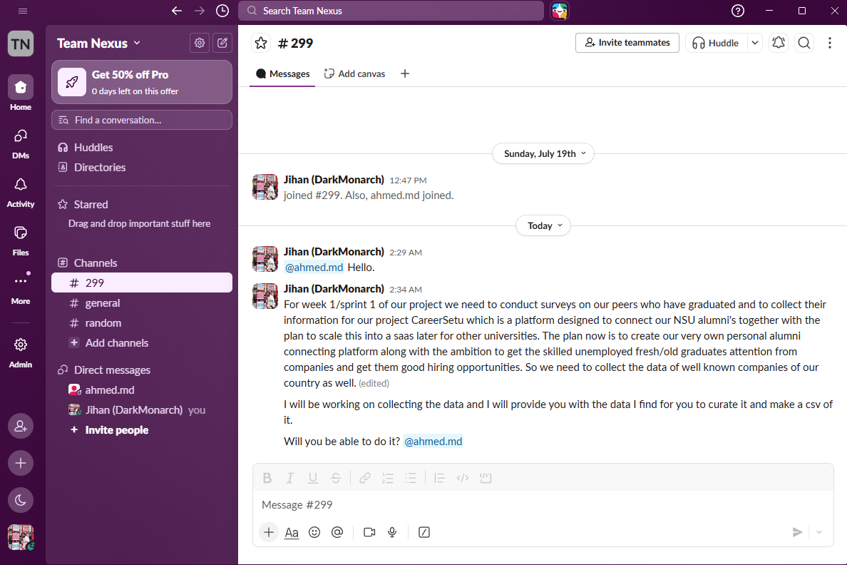
Communication Review
Slack screenshots and metrics:
The communication after joining slack:

Slide 9
Risks & Issues
Risk matrix placeholder
[Not sure what to enter here, your feedback will be very much appreciated Sir.]

Slide 10
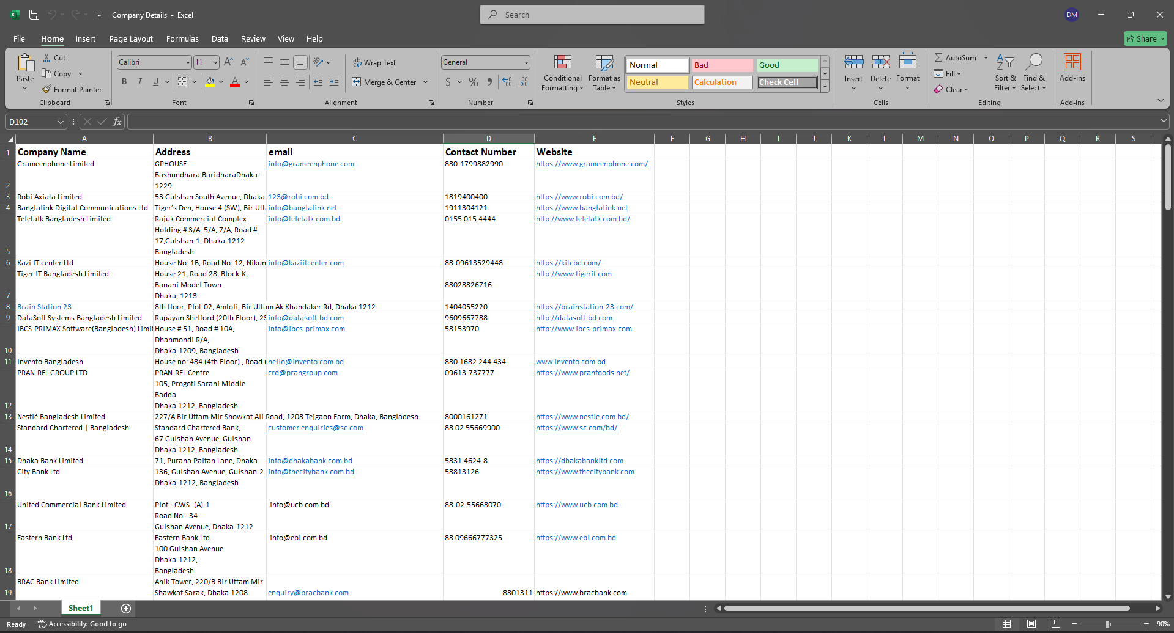
Demo
The screenshot of the companies data curated into a csv format:

Slide 11
Next Sprint
Tasks: Creating repository on local drive and designing a valid CI/CD pipeline.
Contributors: Jihanur Rahman & Tahsin Ahmed
Deadlines: 21 July, 2026
[Replace this area with your content/screenshots.]

Slide 12
Instructor Feedback
Scoring rubric:
Respected ITN Sir,
we are looking forward to your feedback and improving our project accordingly.

